Slide 1
HEL-8023:
A bioinformatics approach to study long non-coding RNAs
Peter Utnes
PhD student: lncRNA in aggressive neuroblastoma
Neuroblastoma Research Group, UNN
MSc Molecular Biotechnology

Slide 2

Notes:
LiveSlide Site
https://github.com/utnesp

Slide 3
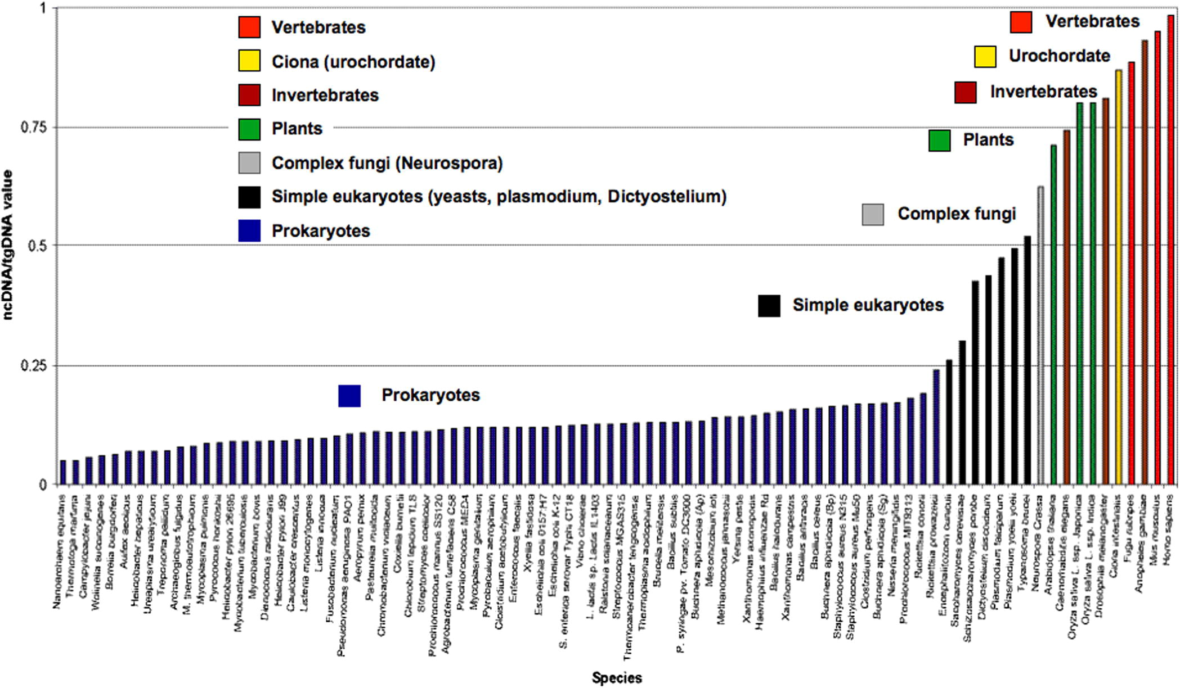
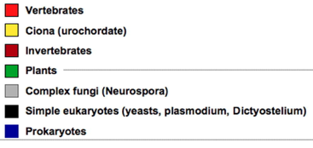
The increase in non-coding DNA in evolution correlates with increase in developmental complexity
http://www.i-sis.org.uk/Noncoding_RNA_and_evolution_of_complexity.php
Adapted from Mattick JS., FEBS Letters 2011.

Slide 4
Introduction: RNA classes
mRNA
Small non-coding RNAs
≲ 200 nt
miRNA
tRNA
snRNA
snoRNA
+++
piRNA
siRNA
Long non-coding RNAs
≳ 200 nt
long intergenic RNA (lincRNA)
antisense RNA
rRNA
circRNAs
+++
ceRNAs
sense RNA
TERRA
T-UCR
Leu
Pro
aa
Cys
Gene regulation
His
Gene reg. in germ cells
5’
3’
Exogenous
aa
aminoacid
tRNA
miRNA
Splicing &
RNA processing
mRNA
ribosome
RNA modification

Slide 5
Notes:
LiveSlide Site
http://www.gencodegenes.org/stats/current.html

Slide 6
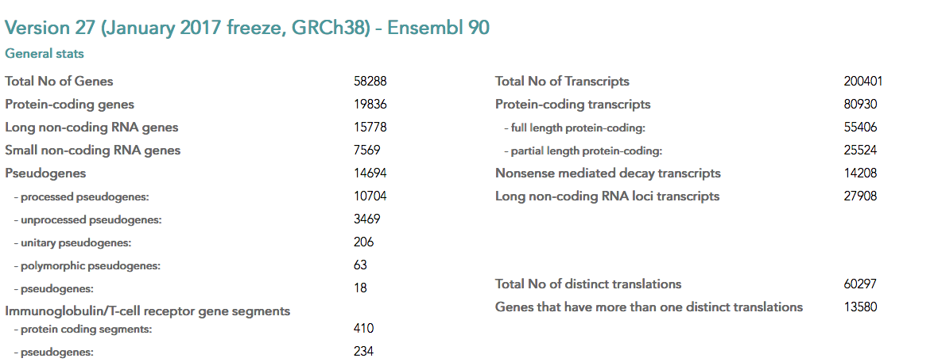
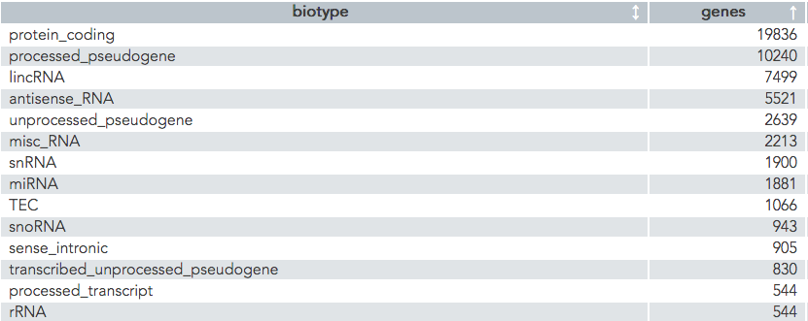
http://www.gencodegenes.org/stats/current.html

Slide 7
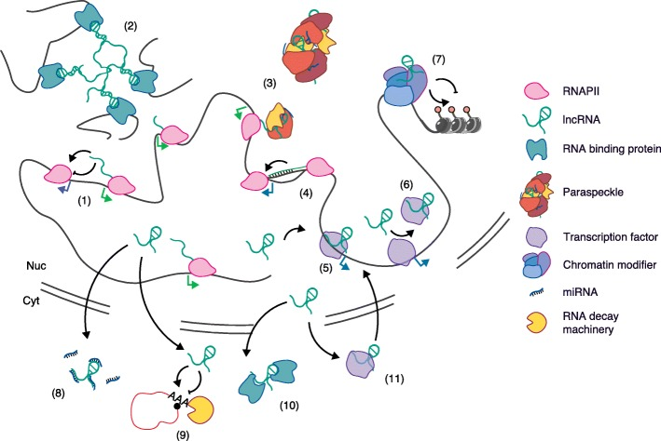
lncRNAs are important in many cellular processes
Marchese et al. Genome Biol 2017.
Notes:
ncRNAs can regulate gene expression by different mechanisms, some of which are illustrated here. These modes of action include lncRNA transcription-dependent activation or repression of neighbour genes (1), lncRNA-mediated inter-chromosomal interactions (2), formation of nuclear structures (i.e. paraspeckles) (3) or R-loops (4), lncRNAs as guide (5) or decoy (6) of transcription factors or as a scaffold for chromatin modifying complexes (7), lncRNAs acting as sponges of miRNAs (8), regulating post-transcriptional mRNA decay (9), regulating the cellular localization of RNA-binding proteins (RBPs) (10) or DNA-binding proteins (DBPs)

Slide 8
Expression pattern of lncRNAs
Gene-level view
PolyA RNA-seq from
161 high-risk neuroblastoma cases
lncRNAs compared to proteins:
Less abundant
Lower expression levels
https://github.com/utnesp/cumulative.plot.R

Slide 9
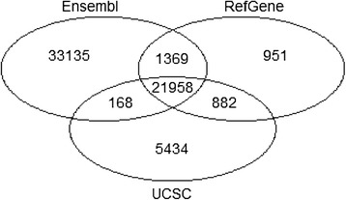
Workflow considerations
RNA
BACE1
-- preserve strand information
-- polyA
-- totalRNA (ribo-minus)
5’
3’
Library preparation
3’
5’
BACE1-AS1
RNA sequencing
read depth: > 20 x 10^6 polyA+
short vs long* read sequencing: Illumina, MinION*, PacBio*
*high error rate (30 %)
Mapping and annotation
In silico analysis
Zhao & Zhang, BMC Genomics 2016

Slide 10
Determining coding potential
Sequence based prediction based on:
Codon usage frequencies
Contains ORF > 90 bp
K-mer frequency tables in protein coding genes
Tools:
PhyloCSF Phylogenetic analysis of multi-species genome sequence alignments to identify conserved protein-coding regions
PLEK Predictor of long non-coding RNAs and messenger RNAs based on an improved k-mer scheme
CPAT Coding-Potential Assesment Tool
LncRNA-ID Long noncoding RNA IDentification
LncRScan-SVM
ATG (GTG / TTG) … … … TGAGGCCAGGAGATGGAG… … … TAG / TAA / TGA

Slide 11


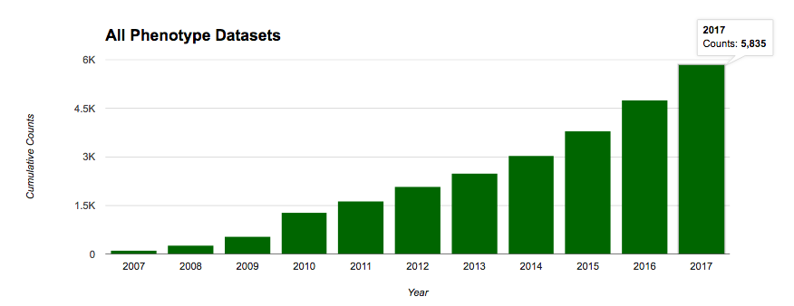

Storing and obtaining high throughput data
70 515 experiments
https://www.ebi.ac.uk/arrayexpress/
91 826 series
https://www.ncbi.nlm.nih.gov/geo/
http://dbgap.ncbi.nlm.nih.gov

Slide 12
Notes:
LiveSlide Site
https://www.ncbi.nlm.nih.gov/projects/gap/summaries/cgi-bin/molecularDataPieSummary.cgi

Slide 13
Gene co-expression analysis
Associate genes with unknown function to known biological processes, pathways, disease etc.
Infer functions and disease associations
Correlation coefficient: -1≤r≤1
Positive correlation: 0 < r ≤ 1
Negative correlation: -1 ≤ r < 0
Types of correlation analysis
Parametric: Pearson
Non-parametric: Spearman rank, Kendall

Slide 14
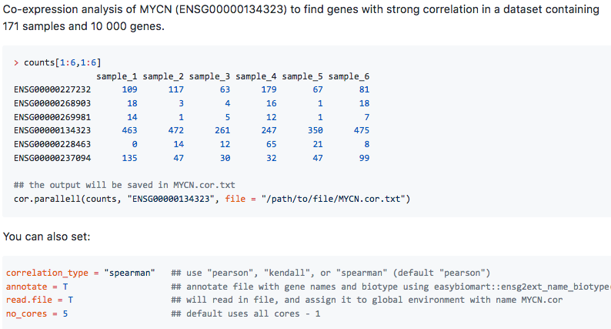
https://github.com/utnesp/Faster-R-cor-function

Slide 15
Finding differentially expressed genes
Design
Treatment vs Control (GEO, ArrayExpress)
Disease vs Healthy individuals (dbGaP)
Filtering of low counts
GLM: Model fitting based on negative binomial distribution
Compare models (H₀ vs H_{a}) using LRT
edgeR and DESeq
Multiple testing (p.adj)
DIY with Chris and Endre

Slide 16
High throughput methods for studying lncRNA interactions
RIP-seq
CLIP-seq
Y
RNA-pull down assay followed by mass spectrometry and / or sequencing
Y
RNA-BP
antibody
lncRNA
RNA tag
(biotin)
Streptavidin coupled to magnetic beads
DNA or
chromatin
RNA
Notes:
http://www.lncrna-test.caltech.edu/protocols.php

Slide 17
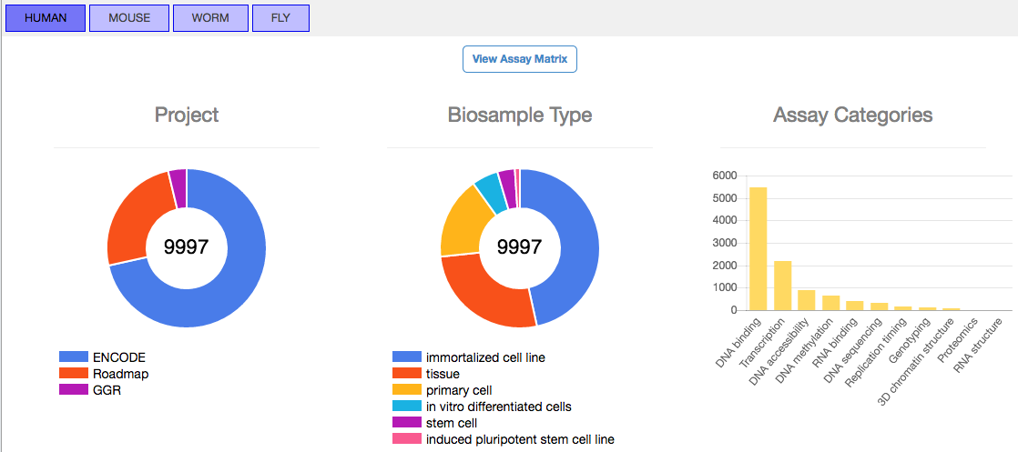
ENCODE: Encyclopedia of DNA Elements

Slide 18
Short bash tutorial with ENCODE data

Slide 19
ENCODE CLIP/RIP
RNA pull-down Lee
409
364
HNRNPH1 FUBP3 PUM2
439
RNA pull-down Tichon
FUBP3
PUM2
Sense
Antisense
Notes:
Spectral index ratio was calculated based on Spectral Index signals with a prior count of 1 to avoid dividing with zero numbers.
Tichon: Database: the uniprot_Human_20140709 database (unknown version, 89005 entries)

Slide 20
Notes:
LiveSlide Site
https://github.com/utnesp

Slide 21
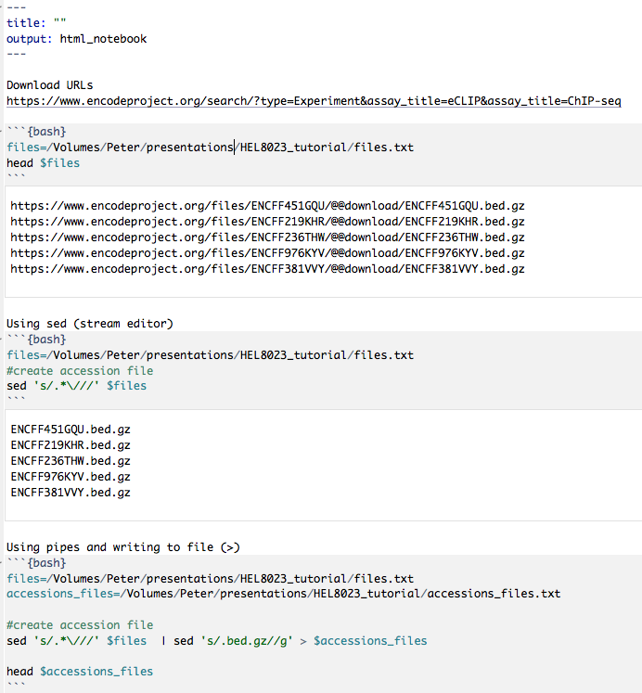

Slide 22
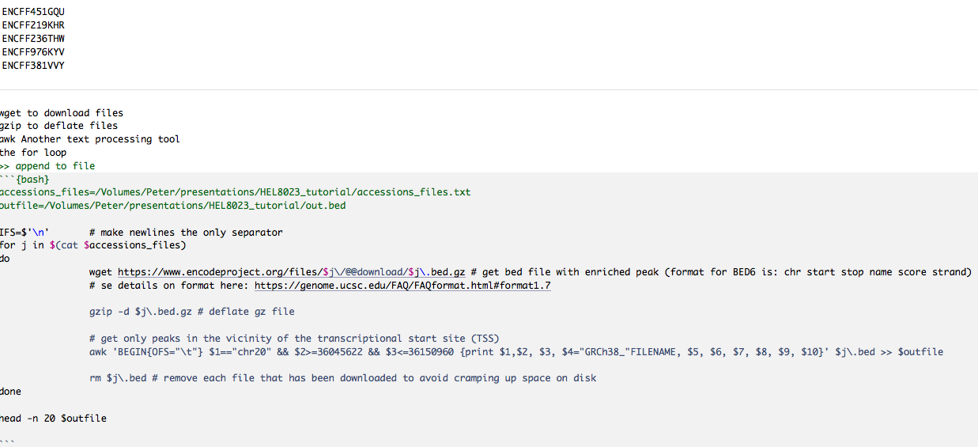

Slide 23
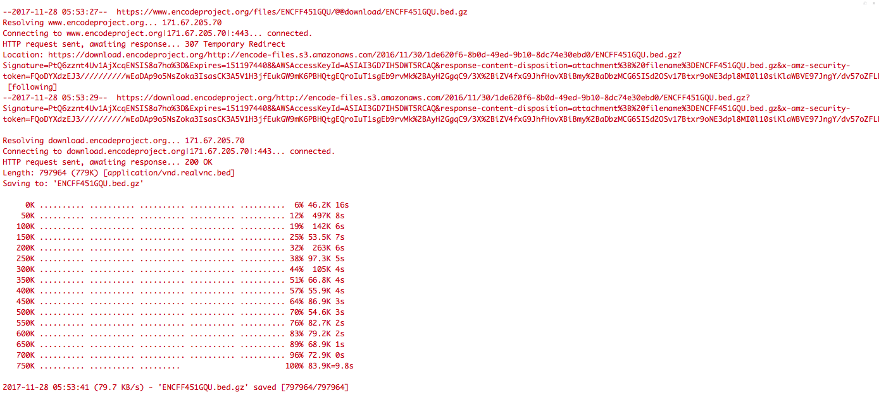

Slide 24
